Slide 1
Looping Station Application
By Luis Garcia

Slide 2
Motivation
Musical Outlet
Not musically gifted
Want to challenge myself

Slide 3
The Proposal
To develop my own mobile looping station

Slide 4
Features
Allow the user to record up to 5 tracks in one take
Play/Pause feature for every individual track
Sound Adjustment for the track
Save your tracks for FREE!!!
Application Features

Slide 5
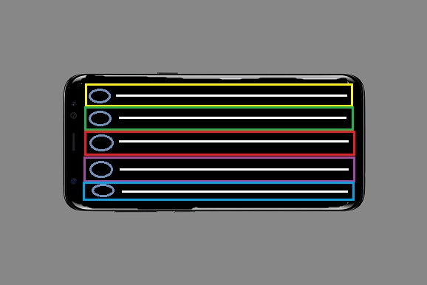
Mockup

Slide 6
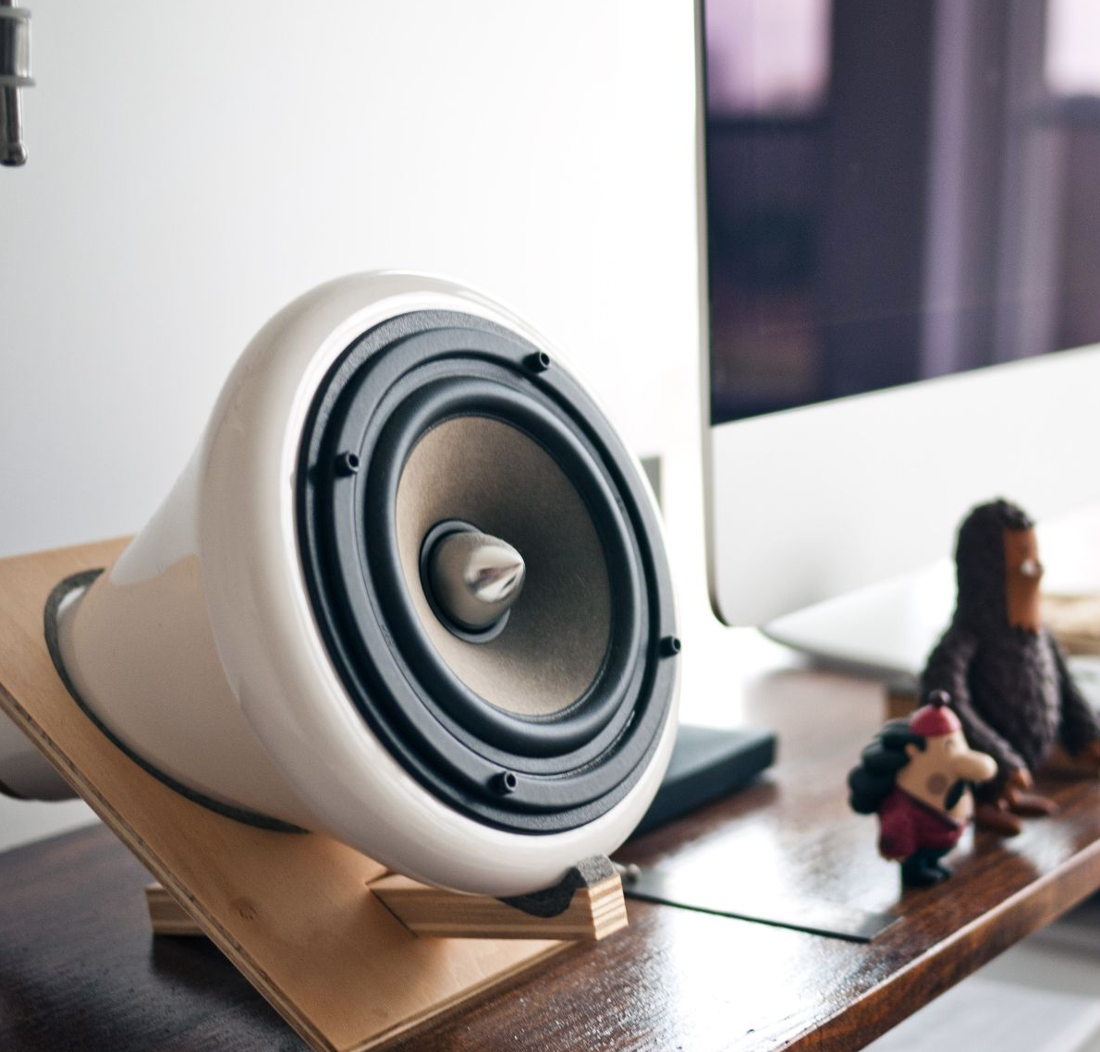
Timeline
When it’s due

